Slide 1
L4i RO stemcell genes from dorgau
William Li

Slide 2
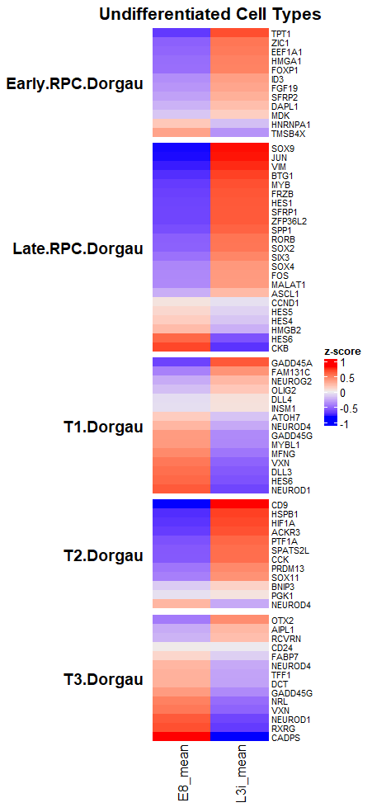
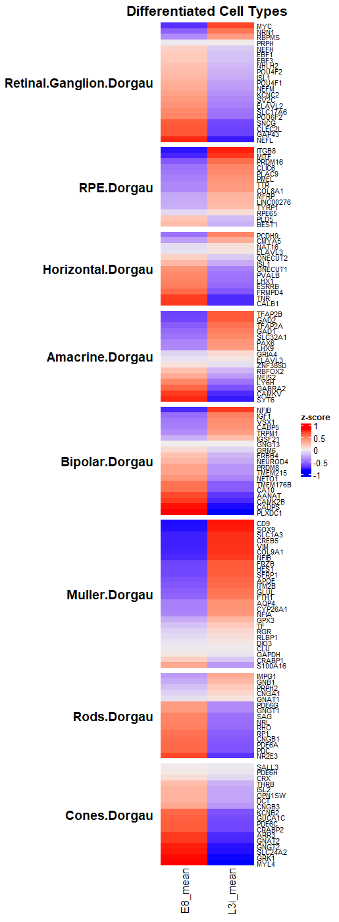

Slide 3
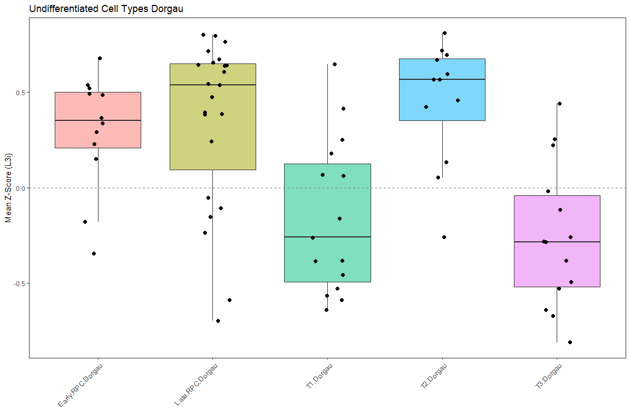

Slide 4
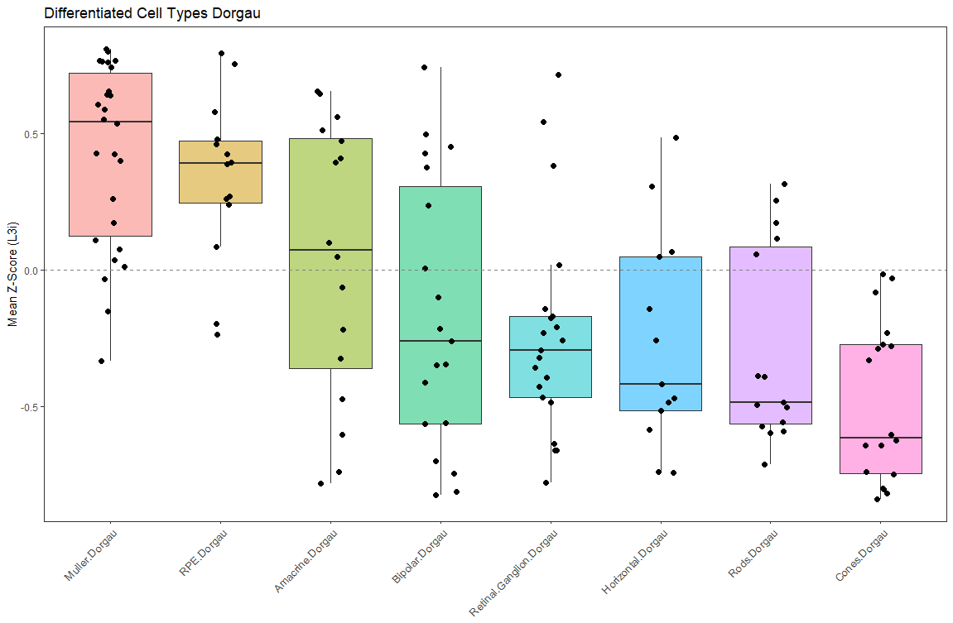

Slide 5
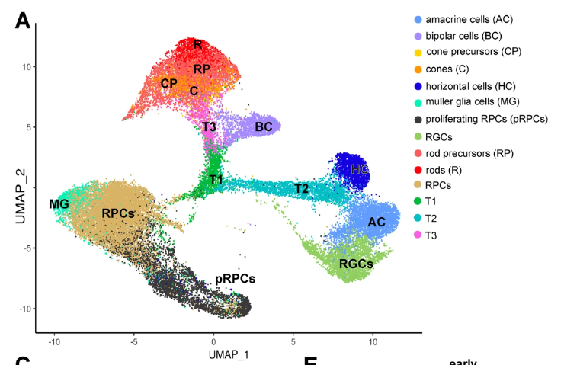
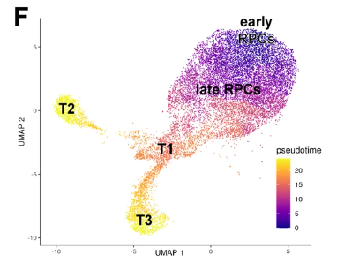
Dorgau figures
“In accordance with the position of T2 between horizontal and amacrine cells, high expression of key transcription factors (PRDM13, ONECUT1, TFAP2A) required for differentiation to these two lineages was observed”
“Similar cell clusters with enriched expression of RPCs and pigmented epithelial cell markers were consistently found in the ciliary margin zone of 10, 11 and 13 PCW eye specimens analysed with the ST approach”

